Slide 1
Oort Constants
夏舒帆

Slide 2
Content
以Oort Constants 为起点学到的
Data analysis
  Fitting
  Distribution of 3 physical quantities: approximately normal
  MCMC technique to find uncertainties
数据处理中遇到的问题
其他问题

Slide 3
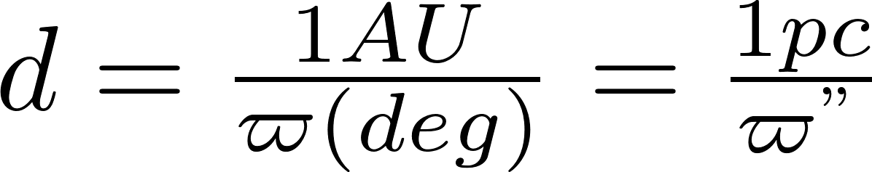
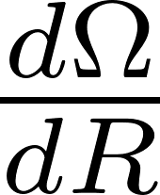
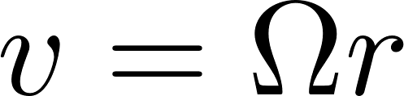
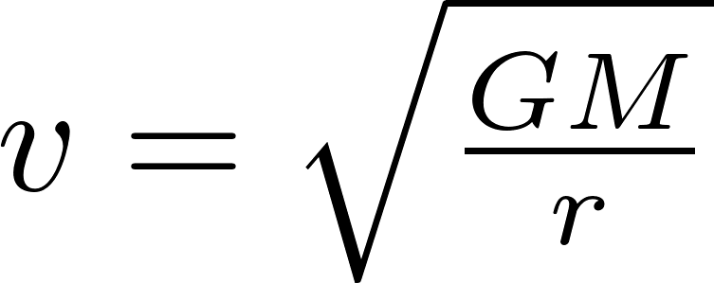

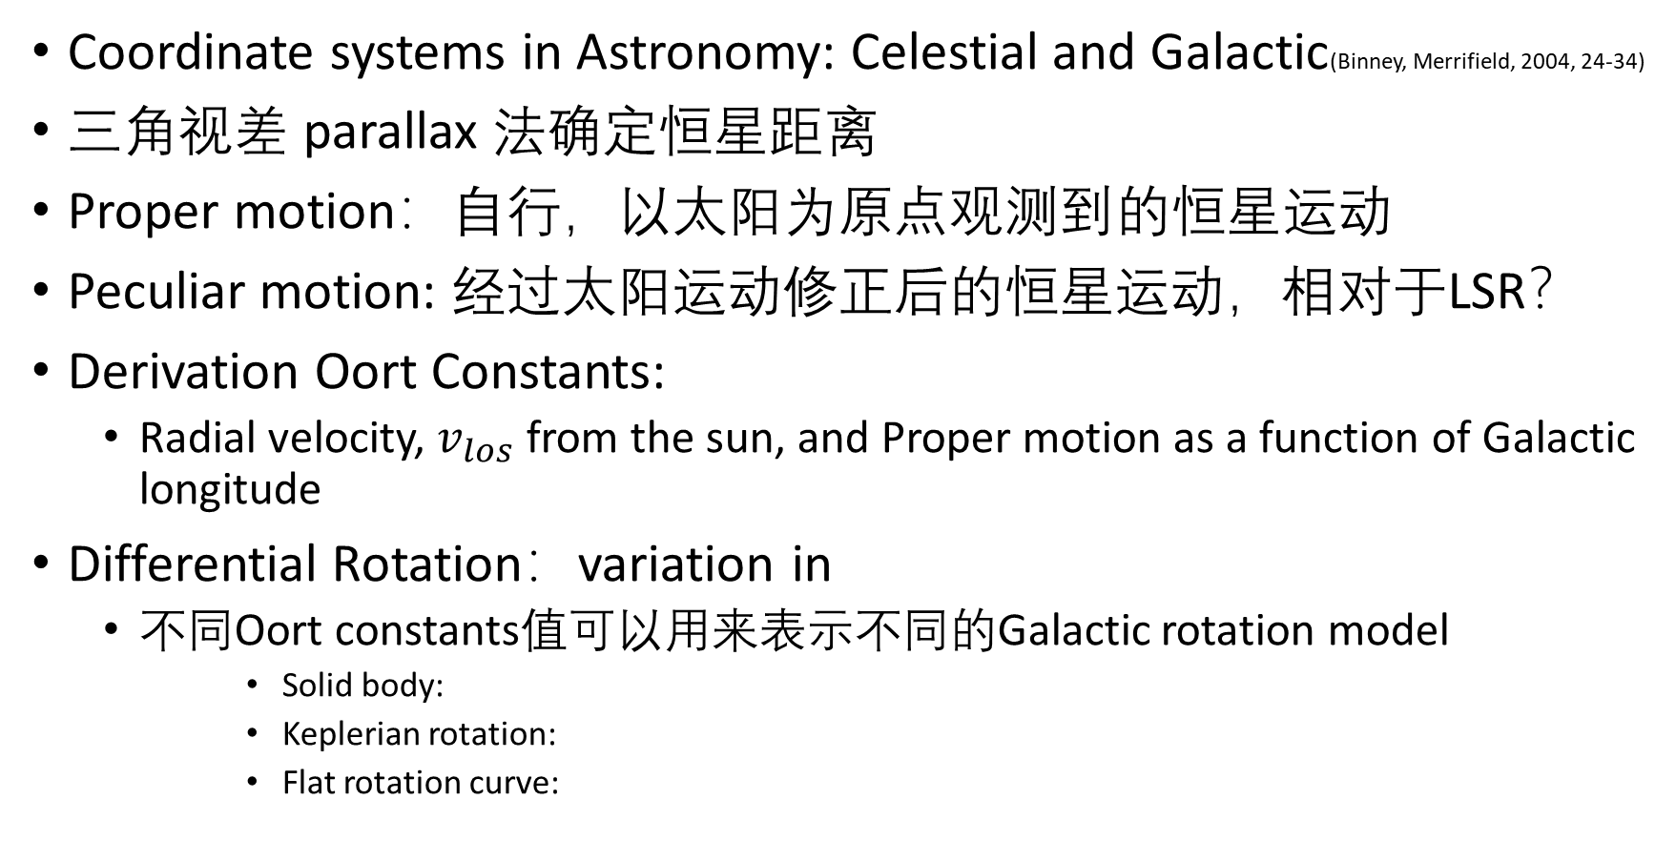
最近学的：
Coordinate systems in Astronomy: Celestial and Galactic(Binney, Merrifield, 2004, 24-34)
三角视差 parallax 法确定恒星距离
Proper motion：自行，以太阳为原点观测到的恒星运动
Peculiar motion: 经过太阳运动修正后的恒星运动，相对于LSR？
Derivation Oort Constants:
  Radial velocity, $v_{los}$ from the sun, and Proper motion as a function of Galactic longitude
Differential Rotation：variation in
  不同Oort constants值可以用来表示不同的Galactic rotation model
      Solid body:
      Keplerian rotation:
      Flat rotation curve:

Slide 4
Key Equations
A)
B)
C)

Slide 5
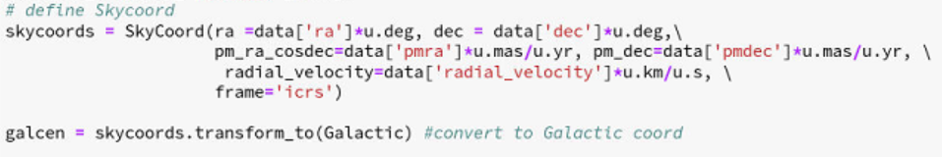

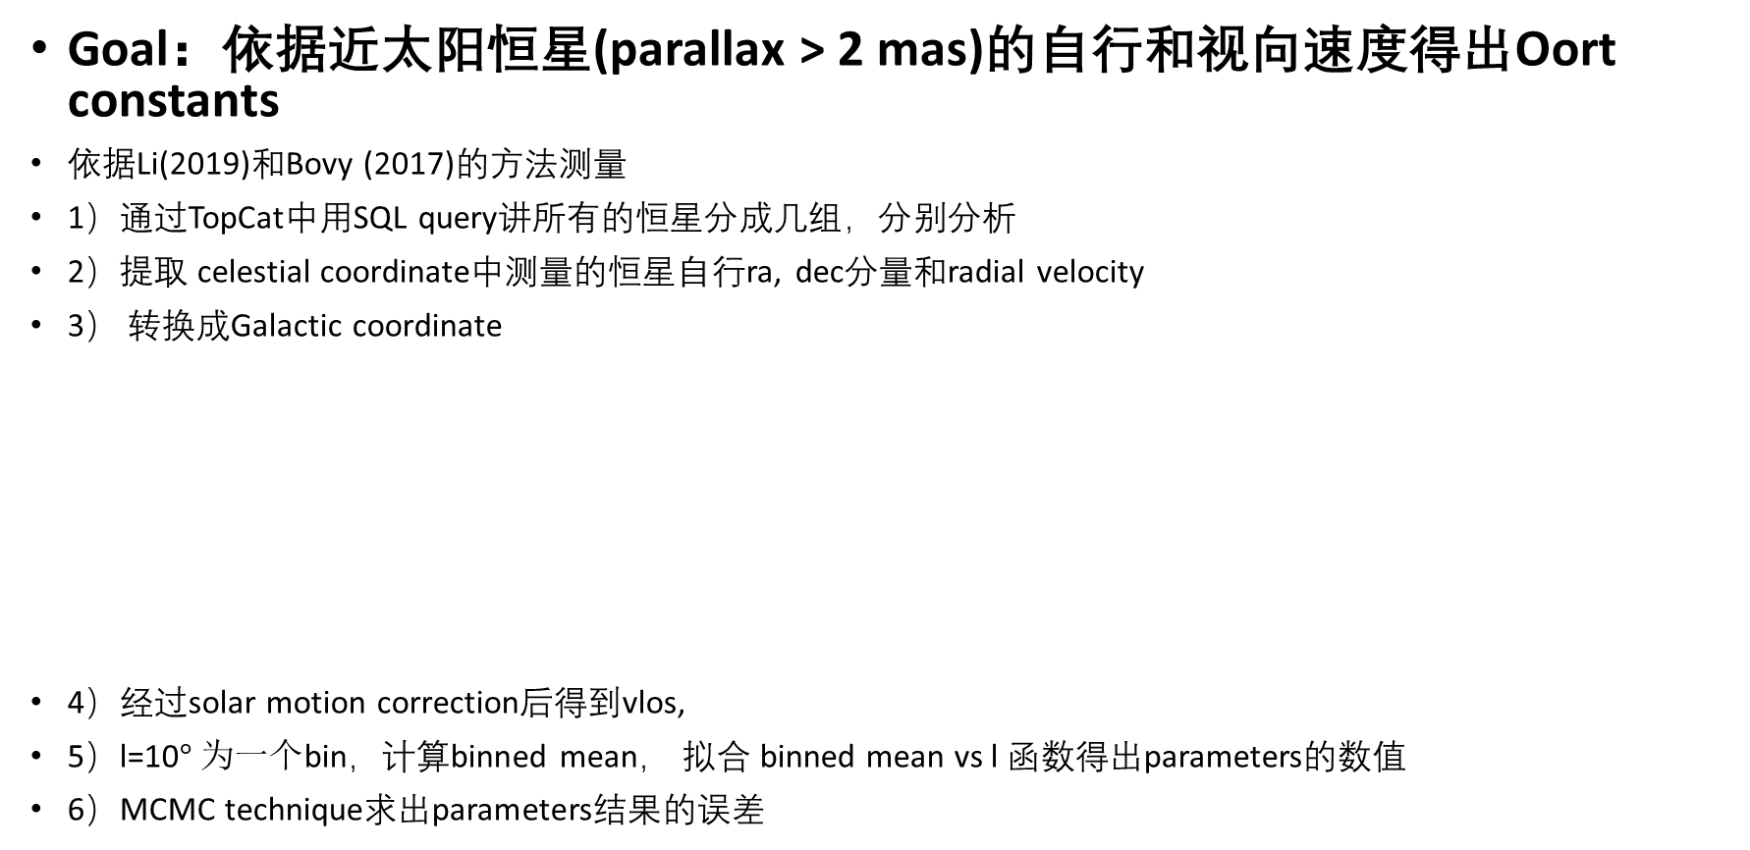
Gaia DR2数据分析：
Goal：依据近太阳恒星(parallax > 2 mas)的自行和视向速度得出Oort constants
依据Li(2019)和Bovy (2017)的方法测量
1）通过TopCat中用SQL query讲所有的恒星分成几组，分别分析
2）提取 celestial coordinate中测量的恒星自行ra, dec分量和radial velocity
3） 转换成Galactic coordinate
4）经过solar motion correction后得到vlos,
5）l=10$° 为一个$bin，计算binned mean， 拟合 binned mean vs l 函数得出parameters的数值
6）MCMC technique求出parameters结果的误差

Slide 6



Criteria for sample division
1) distance from the sun:
2) Stellar population based on color from blue to red
    Color – Color extinction ?
3) Galactic latitude
    <20 for
    40< <50 for

Slide 7

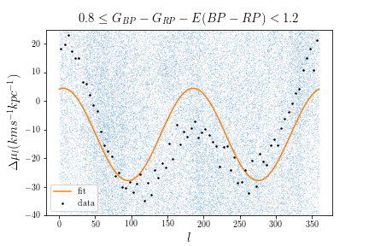
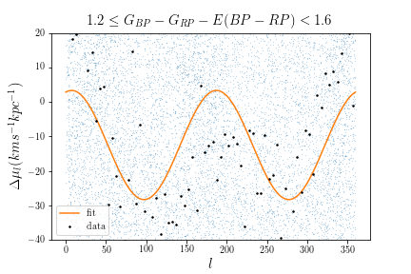
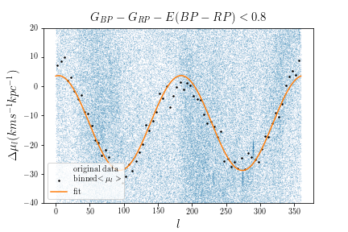
Sample size: 306,872
A: 16.08 B: -12.60 C: -2.29
Sample size: 189,037
A: 15.84 B: -11.7 C: -3.16
Sample size: 43,668
A: 15.33 B: -12.52 C: -3.92
Li:
A= 15.3 +/- 0.2, B=-13.5+/-0.2,
C=-3.0+/-0.2
Li:
A= 15.0 +/- 0.2, B=-13.6+/-0.1,
C=-3.1+/-0.2
Li:
A= 14.9 +/- 0.2, B=-13.4+/-0.2,
C=-2.6+/-0.2

Slide 8
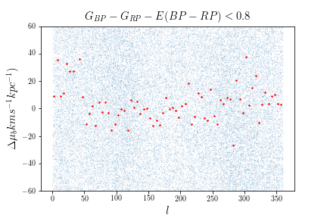
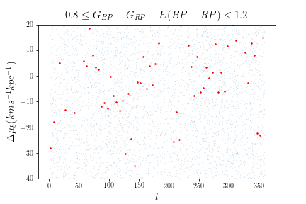
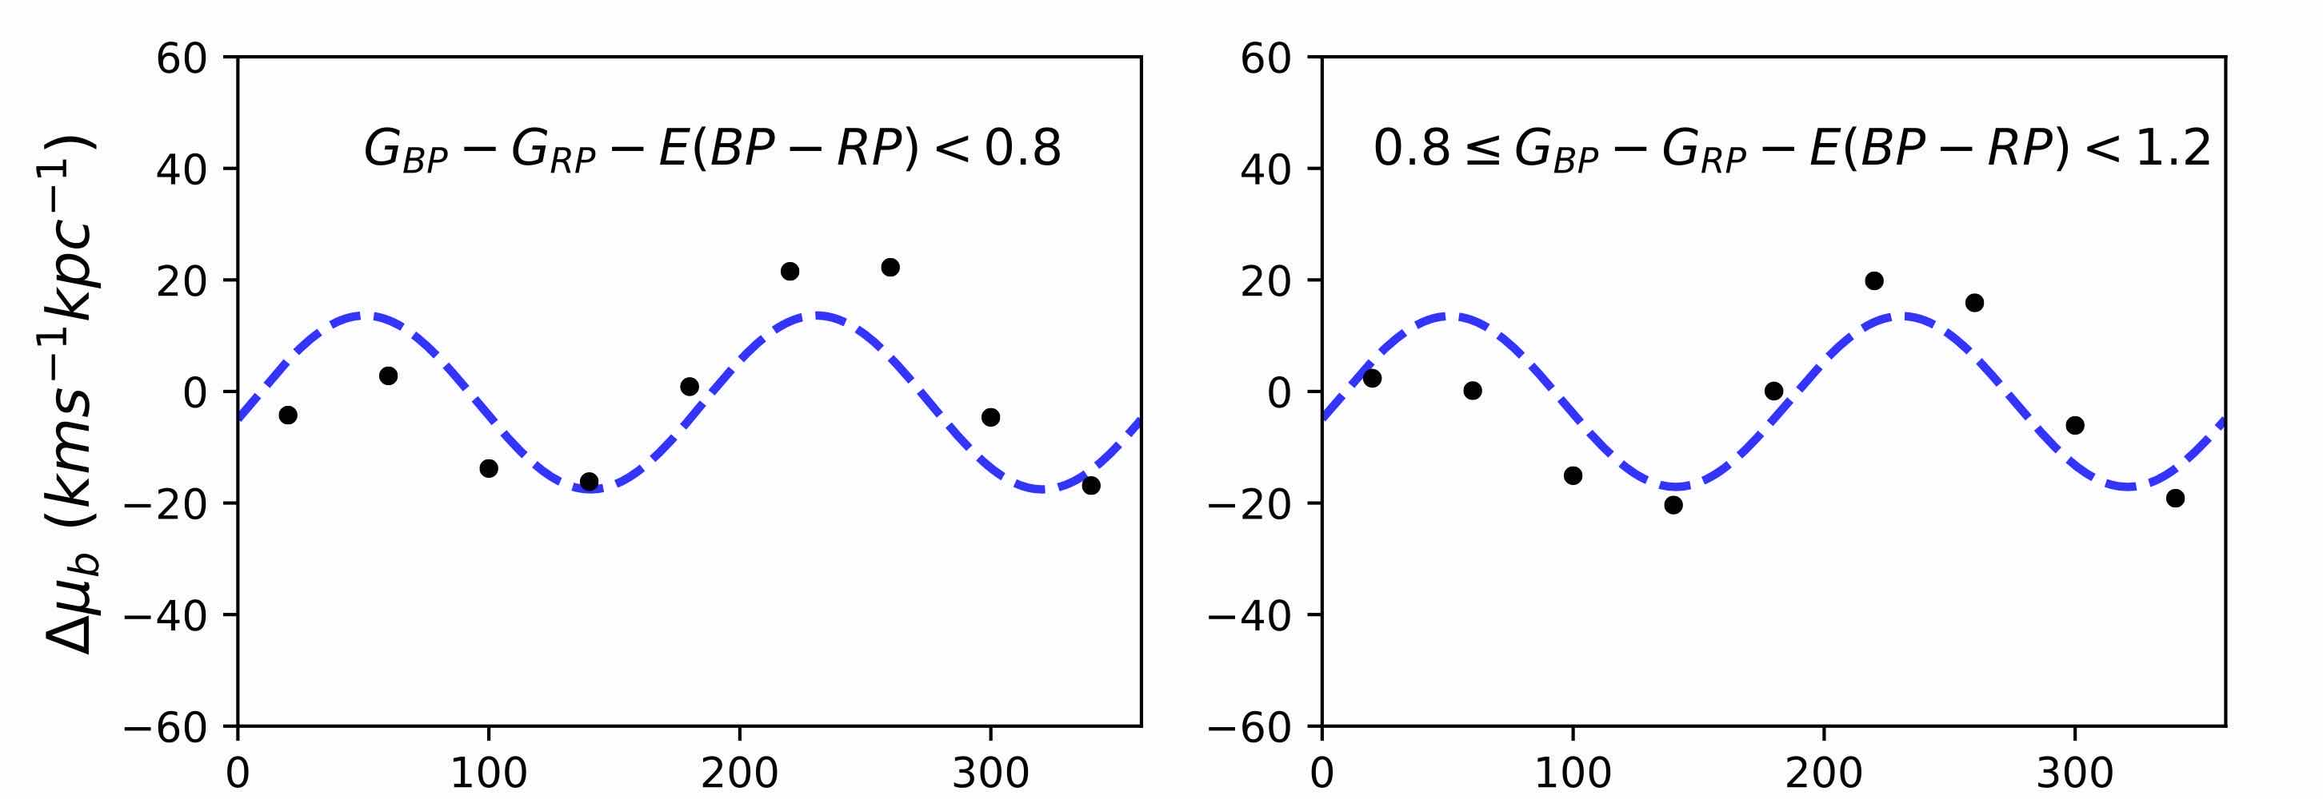
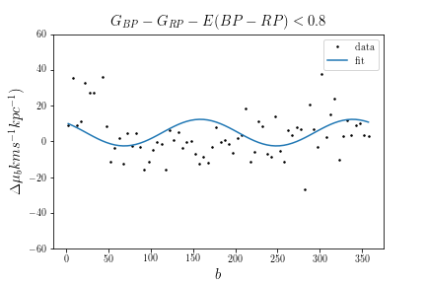
Results from Li (2019)
Sample size is too small:
<0.8: 139,067
>=0.8 and <1.2: 48,173
A=5.46, C=4.85, K=5.04
A= C=, K= (Li,2019)

Slide 9
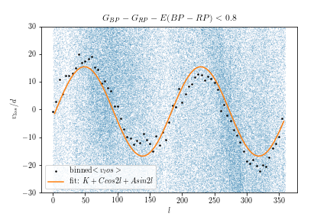
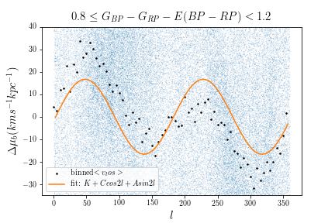

Same samples used to fit binned ${<μ}_{l}>vs l$
A: 16.01 C: -2.20 K: -0.72
A: 16.63 C: -1.72 K: -0.09
Li:
A= 15.3 +/- 0.2, C=-3.0+/-0.2, K = -2.0+/-0.3
Li:
A= 15.0 +/- 0.2, C=-3.1+/-0.2, K = -1.8+/-0.3

Slide 10
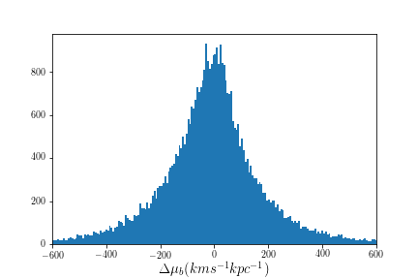
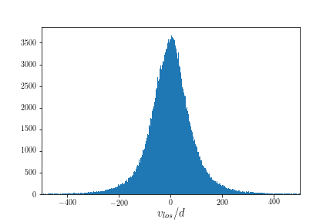
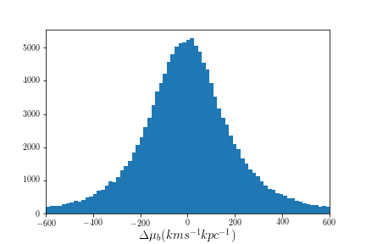
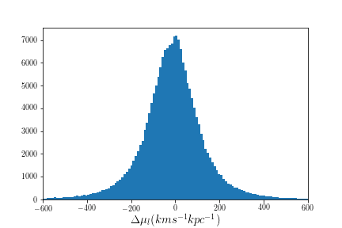
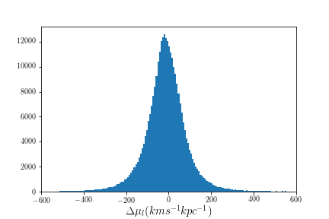
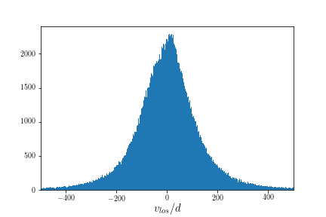

Slide 11
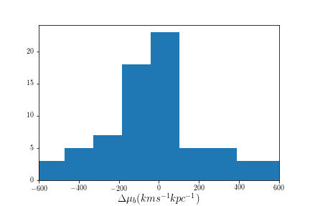
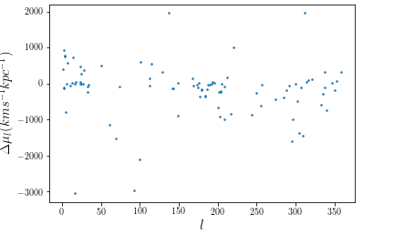
Sample size:

Slide 12
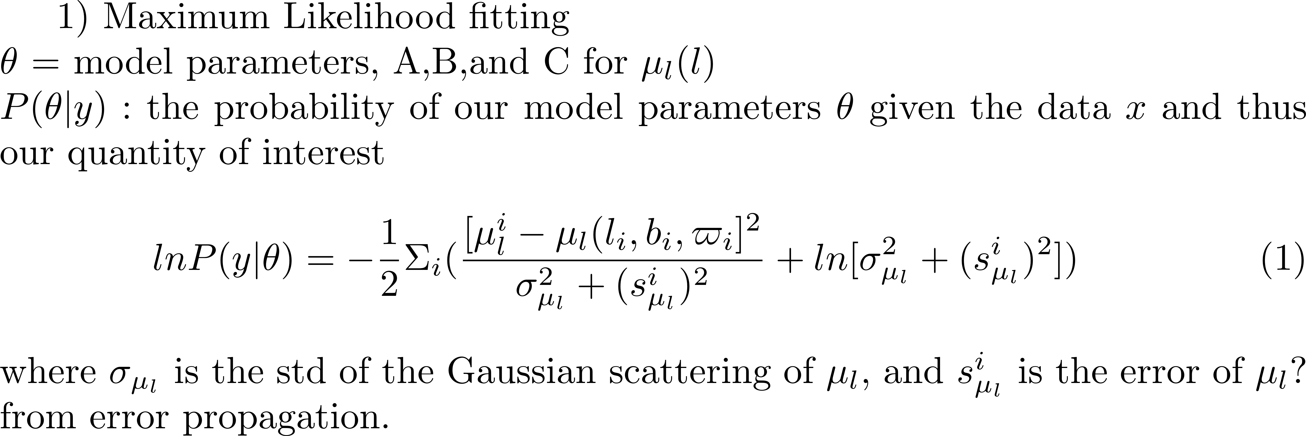
确定 parameters 的 Uncertainties: Markov Chain- Monte Carlo (MCMC) technique
Sampling from a high-dimension / complex probability distribution to approximating the desired quantity
- sample from the set of parameters that produces the models that well-fit our data
likelihood function based on the data + Prior distribution
→ Posterior distribution of the parameters
“MCMC.” n.d. Accessed June 21, 2020.

Slide 13
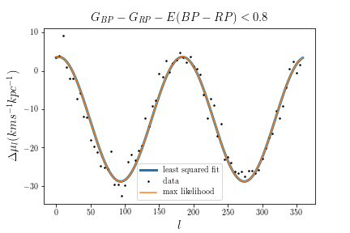
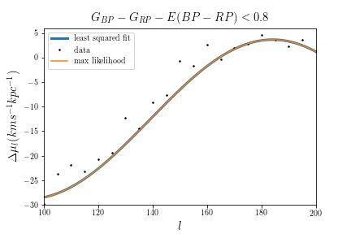
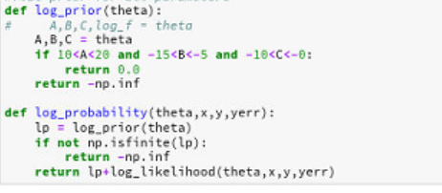
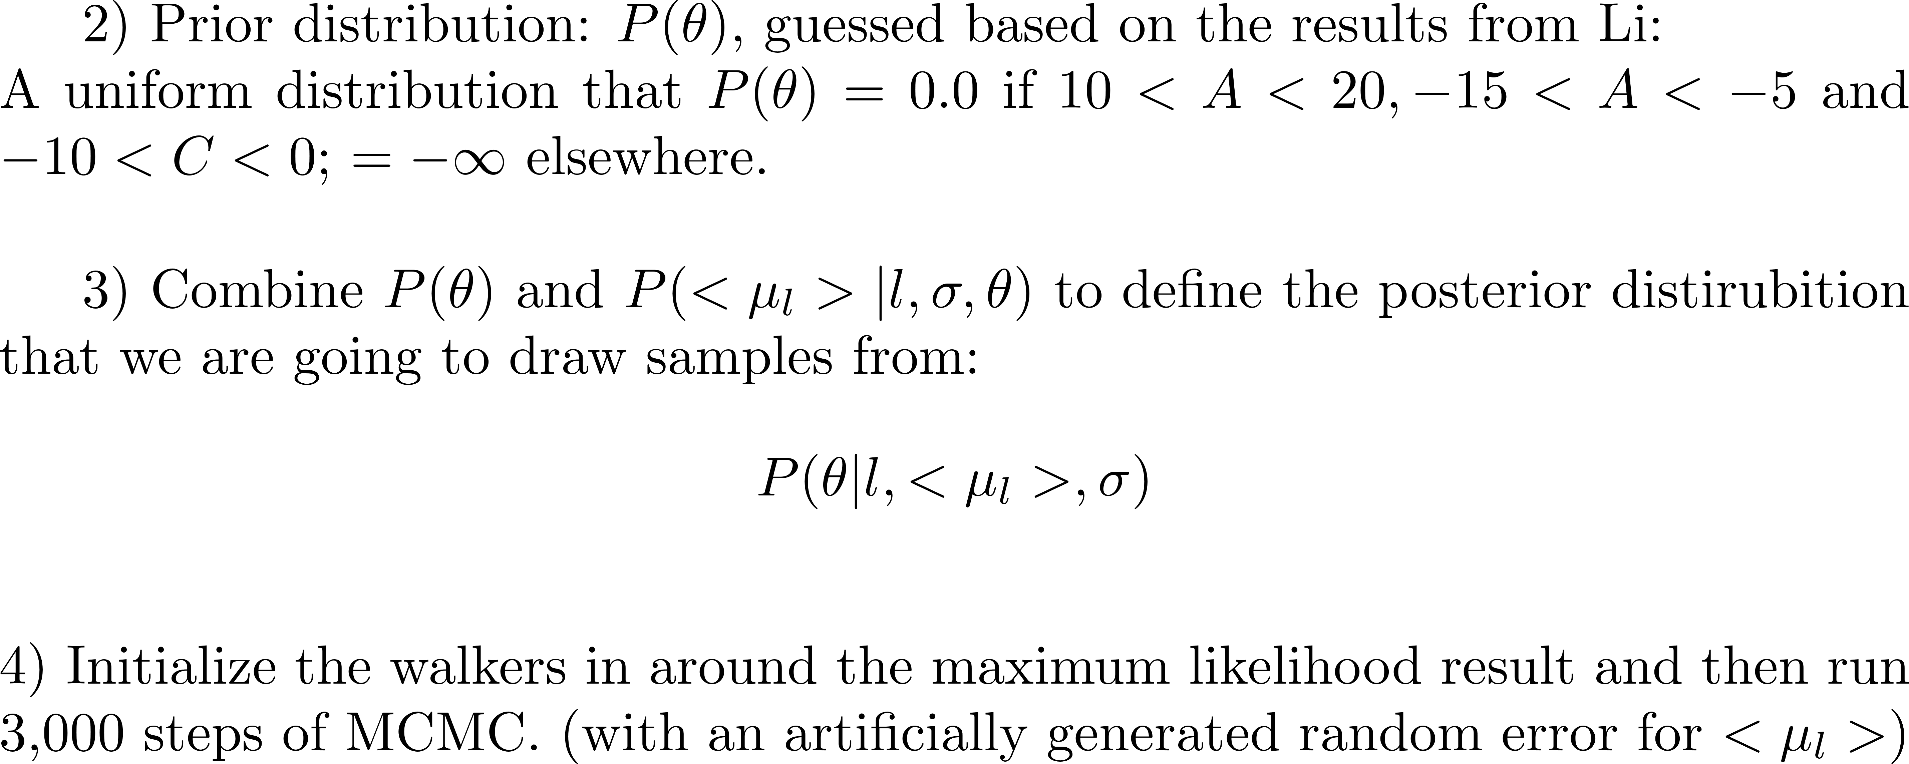
Prior distribution
Posterior distribution

Slide 14
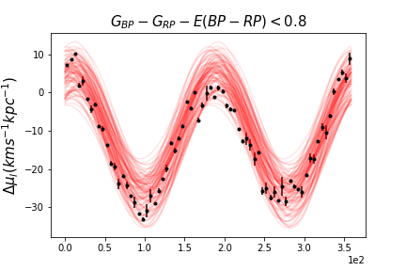
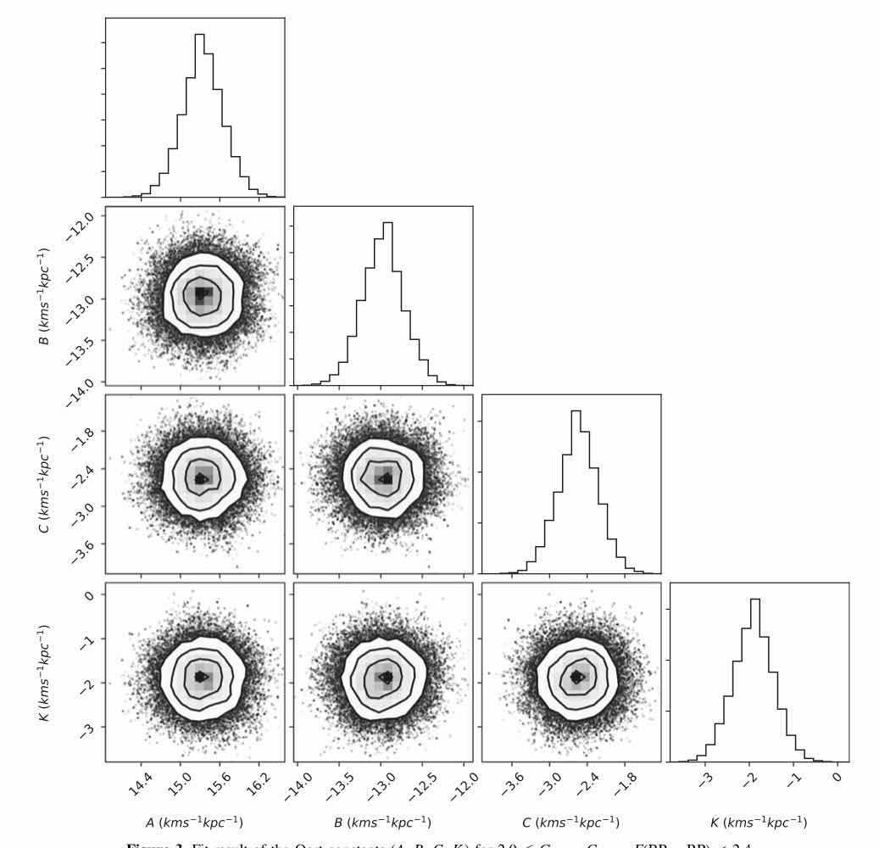
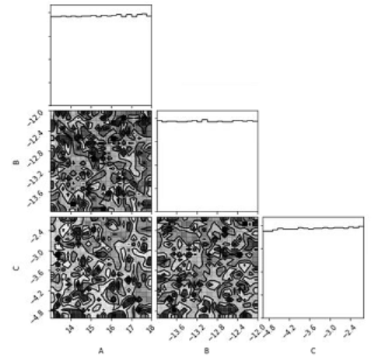
Li. 2019
My result
My simulations: all parameters have not converged!!

Slide 15
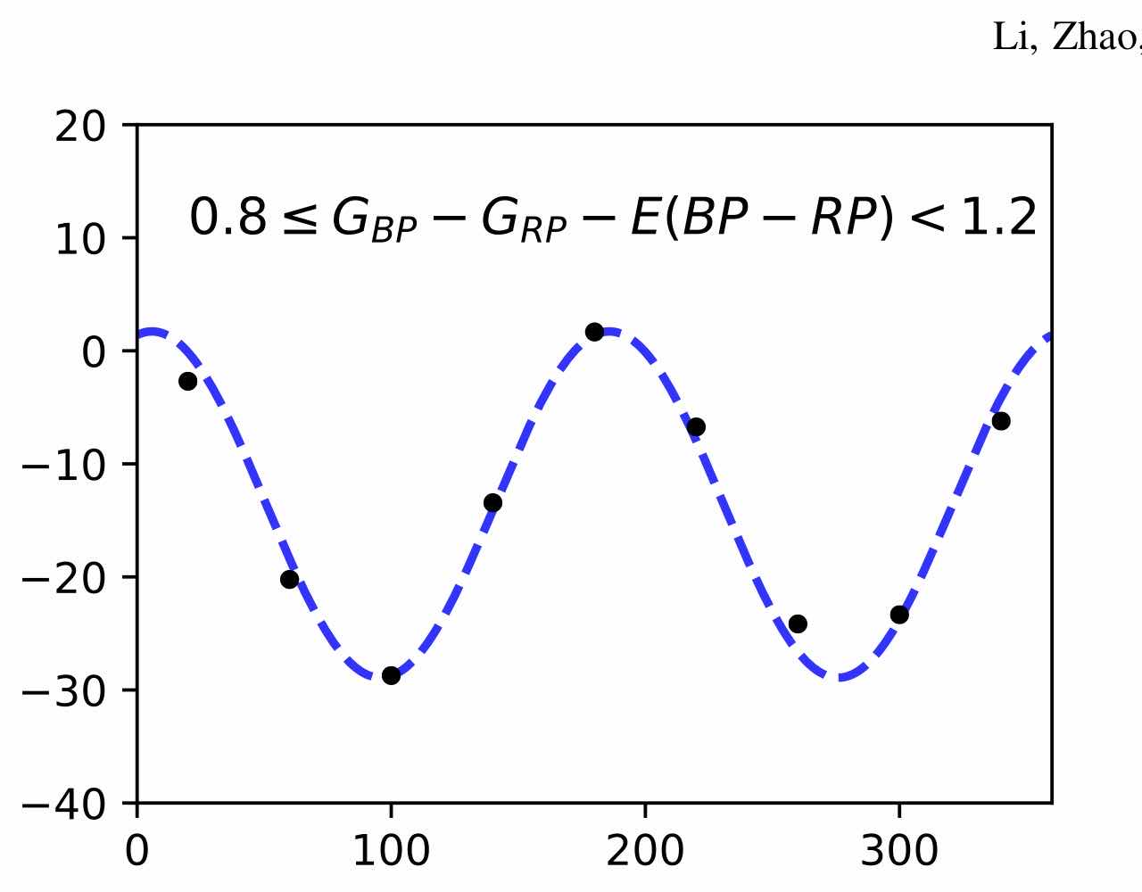

下一步和数据分析中的问题
最蓝的星群$μ_{l}(l)$结果与Li的相近，其他星群的结果与Li 和 Bovy的结果相差明显
Li和Bovy提及选取主序星进行分析，我没有这样做
Query数据时额外要求了该恒星须有radial velocity的数值
计算error, error propagation
  fit的实际是binned mean vs l，这里的error应该用什么，使用binned mean的std非常大，但觉得$μ_{l}$的error不贴切。
Li 和Bovy在拟合函数时，likelihood同时考虑$了μ_{l}和μ_{b}$, 但是我只单独考虑了$μ_{l}$，因为$μ_{b}$的sample数太少
MCMC: walker vs iteration number in run_mcmc() ?
Li,2019
Li,2019

Slide 16
其他问题
Gaia 的望远镜在太空中，怎么测出相对于celestial coordinate的测量? Gaia所测量的radial velocity是以什么为圆心
: Periodicity = 2l. Is it just something arises from trigonometry or it relates to any intrinsic property of the universe
A: shearing and B: voracity, 怎么去visualize？不是很理解Oort constants的意义

Slide 17
References
Bovy, J. 2017, MNRAS, 468, L63
Chengdong Li, Gang Zhao, and Chengqun Yang, Astrophys. J., 872, 205, 2019.
Foreman-Mackey, D., Hogg, D. W., Lang.D., & Goodman, J. 2013, PASP, 125,306
“Fitting a Model to Data — Emcee 3.0.2 Documentation.” n.d. Accessed June 21, 2020. https://emcee.readthedocs.io/en/stable/tutorials/line/#marginalization-uncertainty-estimation.
“MCMC.” n.d. Accessed June 21, 2020. https://prappleizer.github.io/Tutorials/MCMC/MCMC_Tutorial.html.
“3.1.7 Transformations of Astrometric Data and Error Propagation‣ 3.1 Introduction ‣ Chapter 3 Astrometry ‣ Part II Gaia Data Processing ‣ Gaia Data Release 2 Documentation Release 1.2.” n.d. Accessed June 22, 2020. https://gea.esac.esa.int/archive/documentation/GDR2/Data_processing/chap_cu3ast/sec_cu3ast_intro/ssec_cu3ast_intro_tansforms.html.

